Slide 1
Market Consultation Concinnity Conscious Companies Index (KRMATR/KRMAPR) Change of Methodology - Appendix

Slide 2
Summary of KRMA Weighting Issues
Original KRMA weighting system was equal weighted
Equal weighted was simple scheme
S&P 500 was relatively flat (largest individual stocks were ~3% of index)
Historically, research had shown small cap outperforming large cap
Around 2018, FAANGs began to dominate S&P 500
FAANGs/”Magnificent Seven” became over 25% of the index (largest individual stocks were ~7% of index)
S&P 500 became top heavy
Equal weighted portfolio had significant underweights in the top 10 biggest stocks
In 2020, KRMA modified its equal weighting scheme to lower risk from “top heavy” names
No stock in the portfolio could be more than a 1% underweight active bet
After adjustment, the rest of portfolio was equal weighted
KRMA was still underweight mega caps in the portfolio but to a much lesser extent

Slide 3
2015 S&P 500 WEIGHTS
INDEX WEIGHTS UPON LAUNCH OF KRMA
 | 2015 S&P 500 Top 10 Holdings
Ticker | Name | Weight
AAPL | APPLE INC | 3.6%
MSFT | MICROSOFT CORP | 2.1%
XOM | EXXON MOBIL CORP | 1.9%
GE | GENERAL ELECTRIC CO | 1.7%
JNJ | JOHNSON & JOHNSON | 1.5%
BRK/B | BERKSHIRE HATHAWAY INC-CL B | 1.4%
WFC | WELLS FARGO & CO | 1.4%
JPM | JPMORGAN CHASE & CO | 1.3%
META | META PLATFORMS INC-CLASS A | 1.2%
AMZN | AMAZON.COM INC | 1.2%
 | Top 10 Total | 17.4%
 | Bottom 250 Total | 13.5%

Slide 4
CURRENT S&P 500 WEIGHTS
INDEX WEIGHTS (12/31/2023) EXHIBITING INCREASED TOP-HEAVINESS
 | S&P 500 Top 10 Holdings
Ticker | Name | Weight
AAPL | APPLE INC | 7.0%
MSFT | MICROSOFT CORP | 7.0%
GOOGL | ALPHABET INC-CL A | 3.8%
AMZN | AMAZON.COM INC | 3.5%
NVDA | NVIDIA CORP | 3.1%
META | META PLATFORMS INC-CLASS A | 2.0%
TSLA | TESLA INC | 1.7%
BRK/B | BERKSHIRE HATHAWAY INC-CL B | 1.6%
JPM | JPMORGAN CHASE & CO | 1.2%
AVGO | BROADCOM INC | 1.2%
 | Top 10 Total | 32.1%
 | Bottom 250 Total | 10.7%

Slide 5
CURRENT KRMA WEIGHTS
CONCINNITY CONSCIOUS COMPANIES WEIGHTS (INCLUDING 2020 MEGA CAP ADJUSTMENT)
 | Top 10 Holdings in KRMA
Ticker | Name | Weight
AAPL | APPLE INC | 5.8%
MSFT | MICROSOFT CORP | 5.7%
GOOGL | ALPHABET INC-CL A | 2.8%
AMZN | AMAZON.COM INC | 2.2%
NVDA | NVIDIA CORP | 1.9%
META | META PLATFORMS INC-CLASS A | 0.9%
JLL | JONES LANG LASALLE INC | 0.7%
COF | CAPITAL ONE FINANCIAL CORP | 0.6%
AMD | ADVANCED MICRO DEVICES | 0.6%
PHM | PULTEGROUP INC | 0.6%
 | Top 10 Total | 21.8%

Slide 6
KRMA ACTIVE OVERWEIGHTS = KRMA WEIGHTS – S&P 500 WEIGHTS
ALL FOLLOWING SLIDES WILL DETAIL ACTIVE OVERWEIGHTS AND RELATED ISSUES FOR MULTIPLE ITERATIONS OF CONCINNITY CONSCIOUS COMPANIES
CURRENT KRMA WEIGHTS
CURRENT S&P 500 WEIGHTS

Slide 7
CURRENT KRMA ACTIVE OVERWEIGHTS
OVERWEIGHTS CONCENTRATED IN NON-S&P 500 STOCKS
UNDERWEIGHTS CONCENTRATED IN MEGA CAPS AND NON-KRMA STOCKS
Top 10 Overweights
JLL | 0.67%
TWLO | 0.62%
DKS | 0.61%
HUBS | 0.59%
PHM | 0.58%
WDAY | 0.57%
CBRE | 0.54%
WAT | 0.53%
ETSY | 0.53%
LFUS | 0.53%
Top 10 Underweights
BRK/B* | -1.62%
MSFT | -1.33%
AAPL | -1.27%
AVGO* | -1.22%
AMZN | -1.21%
NVDA | -1.14%
TSLA | -1.09%
META | -1.09%
GOOGL | -1.03%
XOM* | -1.00%
*Not in KRMA
KRMA PRODUCES UNDERWEIGHTS IN MEGA CAP STOCKS, EVEN IN THOSE WE OWN

Slide 8
PURE EQUAL WEIGHT KRMA ACTIVE OVERWEIGHTS
UNDERWEIGHTS CONCENTRATED IN MEGA CAPS AND NON-KRMA STOCKS
OVERWEIGHTS CONCENTRATED IN NON-S&P 500 STOCKS
Top 10 Underweights
AAPL | -6.43%
MSFT | -6.38%
GOOGL | -3.22%
AMZN | -2.85%
NVDA | -2.45%
BRK/B* | -1.62%
META | -1.36%
AVGO* | -1.22%
TSLA | -1.11%
XOM* | -1.00%
*Not in KRMA
Top 10 Overweights are all non-S&P 500 stocks (0.60%)

Slide 9
Top 10 Overweights
AAPL | 3.55%
MSFT | 3.46%
GOOGL | 2.72%
AMZN | 1.69%
META | 1.44%
NVDA | 1.33%
V | 0.97%
TSLA | 0.85%
LLY | 0.69%
UNH | 0.60%
PURE CAP WEIGHT KRMA ACTIVE OVERWEIGHTS
OVERWEIGHTS CONCENTRATED IN MEGA CAPS
UNDERWEIGHTS CONCENTRATED IN NON-KRMA STOCKS
Top 10 Underweights*
BRK/B | -1.62%
AVGO | -1.22%
XOM | -1.00%
WMT | -0.56%
ACN | -0.55%
MCD | -0.54%
INTC | -0.53%
LIN | -0.50%
WFC | -0.45%
DIS | -0.41%
*Not in KRMA

Slide 10
Proposed New KRMA Weighting Scheme Overview
What is the ideal weighting scheme for KRMA?
KRMA’s overall, present investment strategy:
Exposure to U.S. large cap (beta of 1 relative to S&P 500)
Invest in companies you can be proud of
Identify companies that adhere to the Multi-stakeholder Operating System (MsOS)
Our alpha “bubbles up” over time, but we can’t guarantee it will show in a specific stock
To capture our alpha, our best approach is to make a series of smaller “bets” across our portfolio
How do we implement this change?
The same active overweight in every stock we own (would equate to ~22bps active overweight in all 166 stocks)
Essentially, we are implementing equal active overweights instead of equal weights
This makes sense – overweights are spread evenly throughout the fund, underweights are stocks not in KRMA
The current/previous weighting scheme produced underweights even in the stocks we liked
We believe this represents a continuation of the size-risk adjustment we made in 2020
How does this affect our risk profile?
Proposed scheme is a risk-reducing adjustment
Tracking error is reduced from 2.2% to 1.1%
Largest sector bet increases from 3.8% to 5.7% (Health Care)

Slide 11
Top 10 Overweights*
ABBV | 0.30%
CSCO | 0.29%
MRK | 0.27%
VRTX | 0.26%
CVX | 0.26%
JNJ | 0.25%
UNH | 0.25%
GILD | 0.25%
PG | 0.25%
HUBS | 0.25%
PROPOSED NEW WEIGHT KRMA ACTIVE OVERWEIGHTS
OVERWEIGHTS SPREAD THROUGHOUT CAP SPACE
UNDERWEIGHTS CONCENTRATED IN NON-KRMA STOCKS
*Weights set to 22bps 30 days prior – listed stocks are largest drifters
PROPOSED WEIGHTING PRODUCES SMALL OVERWEIGHTS IN EVERY PORTFOLIO NAME
Top 10 Underweights**
BRK/B | -1.62%
AVGO | -1.22%
XOM | -1.00%
WMT | -0.56%
ACN | -0.55%
MCD | -0.54%
INTC | -0.53%
LIN | -0.50%
WFC | -0.45%
DIS | -0.41%
**Not in KRMA

Slide 12
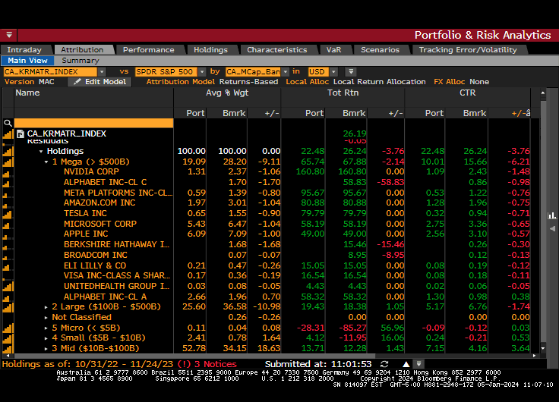
BLOOMBERG TABLE ILLUSTRATING DISPROPORTIONATE EFFECT OF MEGA CAPS ON YTD RETURNS

